Slide 1
Special Topic: Solenoids
Eric Prebys, FNAL

Slide 2
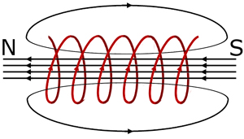
Applications of Solenoidal Fields
Solenoids can provide an arbitrarily uniform magnetic field through a very large and/or extended volume
Solenoids have long been used to create momentum tracking volumes in central high energy physics detectors.
Solenoids can also be used to contain and transport low momentum particles (p up to a few 10’s of MeV) by “trapping” in helical trajectories along the field lines
Concept originally applied to plasma containment
Currently drawing a great deal of interest as a way to transport very large emittance beams of low momentum particles
Particularly useful pions and muons for neutrino physics or muon application.

Slide 3
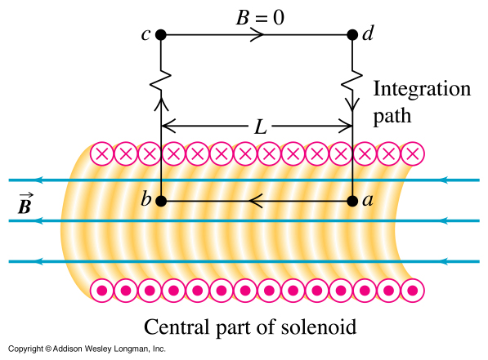
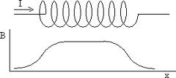
The fields in a solenoid
Within a long solenoid, the magnetic field is more or less uniform, calculated with
The exact formula is
winding pitch
z

Slide 4
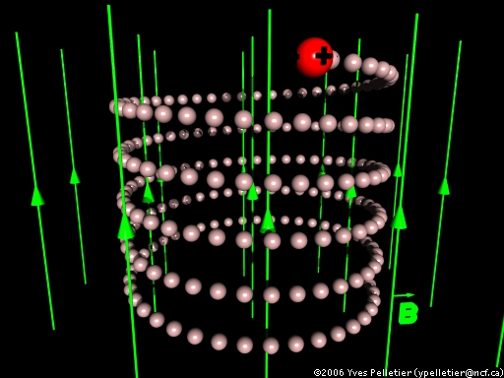
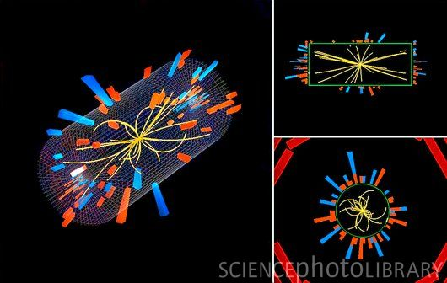
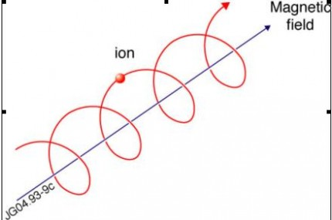
Particle motion in a solenoidal field
Generally, particles move in a helical trajectory
For high momentum particles, the curvature is used to measure the momentum
Low momentum particles are effectively “trapped” along the field lines
10 MeV/c particle will have a radius of 3 cm in a 1 T field
⇒ Solenoids are a powerful tool to transport low momentum particles and can accommodate beams with very large emittances.

Slide 5
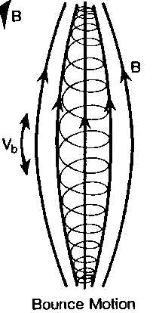
Constants of the motion
Both total momentum and angular momentum are conserved
If qLB||>p₀², then particle will be reflected
Basis of “pinch confinement”

Slide 6
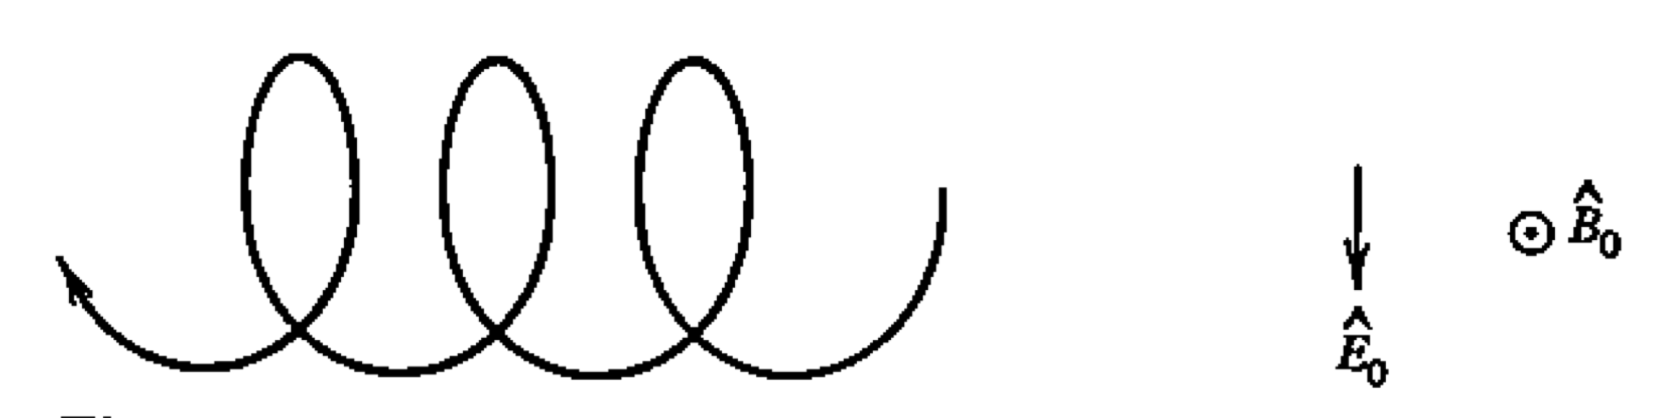
“E cross B Drift”
An electric field transverse to the magnetic will cause a lateral drift, but the average acceleration will be zero.
averaged over a cycle
assume
Cross the magnetic field into this

Slide 7

“Grad-B Drift”
high B➔tight curve
low B➔looser curve
We’ll divide the motion in the cyclical part (v₀) and the drift (v_{g})
Again, cross B into this and we get

Slide 8
For our example

Slide 9
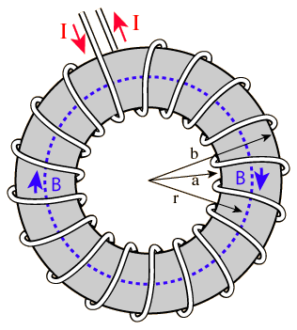
Fields and drift in a Curved Solenoid
Consider a torus:
field in center solenoid
Nominal radius of curvature
x measured outward from center of solenoid
Clearly these formulas will also hold in an area of local curvature R₀.
As the particle moves along the field lines, it will experience a (fictitious) centrifugal force outward.
Component of velocity along B field

Slide 10
This is analogous to the effect of the electric field, so
But we also have a gradient
velocity perpendicular to B
So the total drift velocity is
In most transport applications, this term will dominate
Depends on charge and direction of field, but not on direction of propagation within bend.
out of bend plane

Slide 11
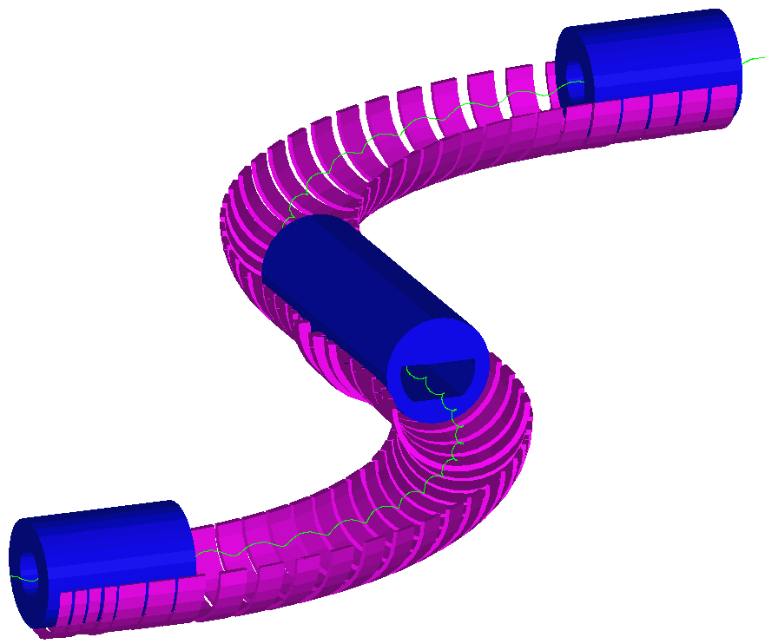
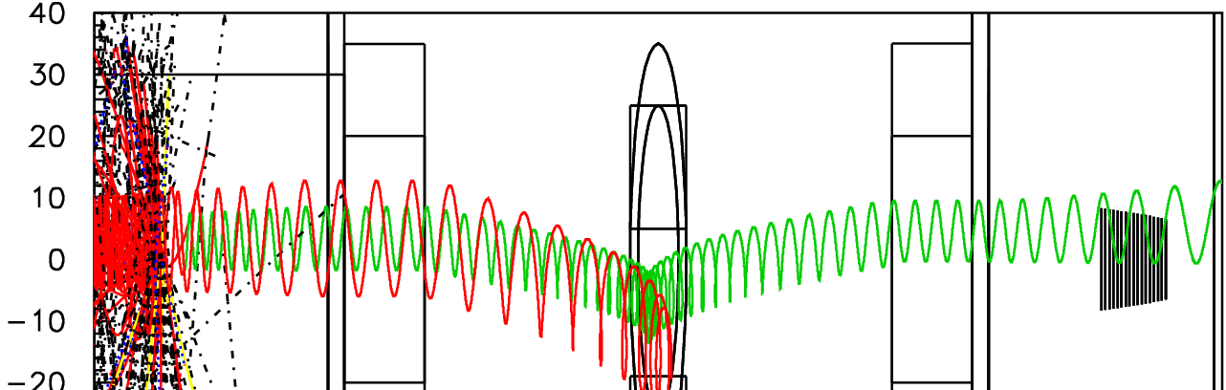
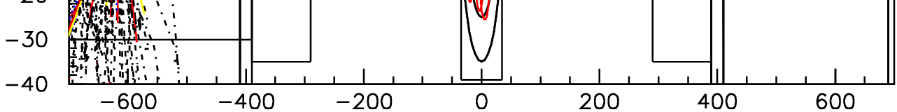
Example: Mu2e Experiment Transport Solenoid
Use curved solenoid to select negative muons with p<90 MeV/c
Curvature drift and collimators sign and momentum select beam
dB/ds < 0 in the straight sections to avoid trapping which would result in long transit times
Collimators and pBar Window
2.1 T
2.5 T

Slide 12
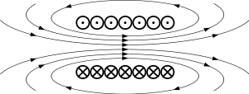
Fringe field of a solenoid
Near the ends, the field of a solenoid will have a radial component
For a long solenoid, this can be approximated near the end as
Integration volume
Measured from end

Slide 13
Understanding solenoidal focusing
Consider a particle coming toward a long solenoid parallel to the axis with velocity v₀
It will see a transverse kick (in the thin lens approximation)
It will begin to travel in a helix described by:
That is, the extrema of he helix will be the radius at the point of entry and the axis of the solenoid

Slide 14
Focusing effect
The radial position and velocity of the particle will be given by
This results in a focusing angle

Slide 15
Effective focal length and coupling
The general form of the previous equation is
At the exit of the solenoid, the particles will receive an opposite transverse kick, but the magnitude will be reduced by r/r₀, resulting in a coupling between the planes
Useful in low energy beam lines
Eg, immediately after ion sources
Also useful in beam lines with large emittances
Eg, muon beams
for unit charge

